Slide 1
MnDOT District 6 Flood Events
Mark Shoenfelder, District Planner
(507) 286-7552
mark.schoenfelder@state.mn.us

Slide 2
Flood History District 6
Presentation Overview:
Precipitation trends
District flood history
Frequency and severity of outcomes
Current MnDOT risk-based assessment tools
Method to determine appropriate response plans for flood events

Slide 3
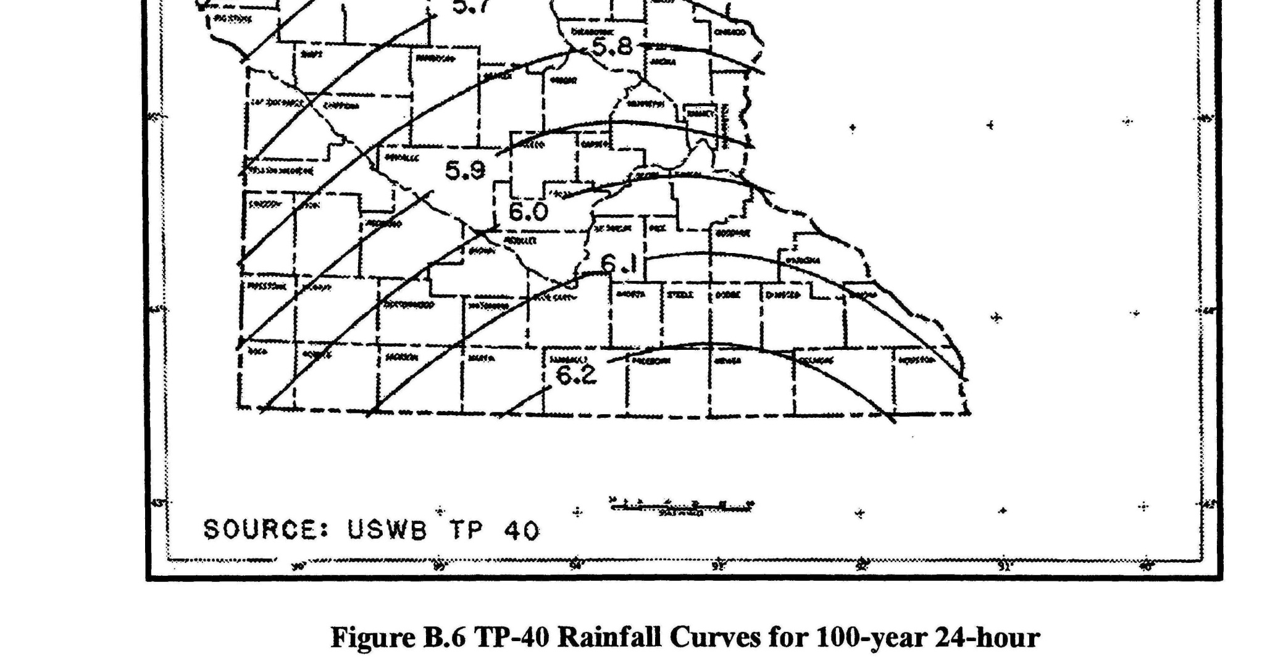
Precipitation Trends
Notes:
Source MnDOT Drainage Manual

Slide 4
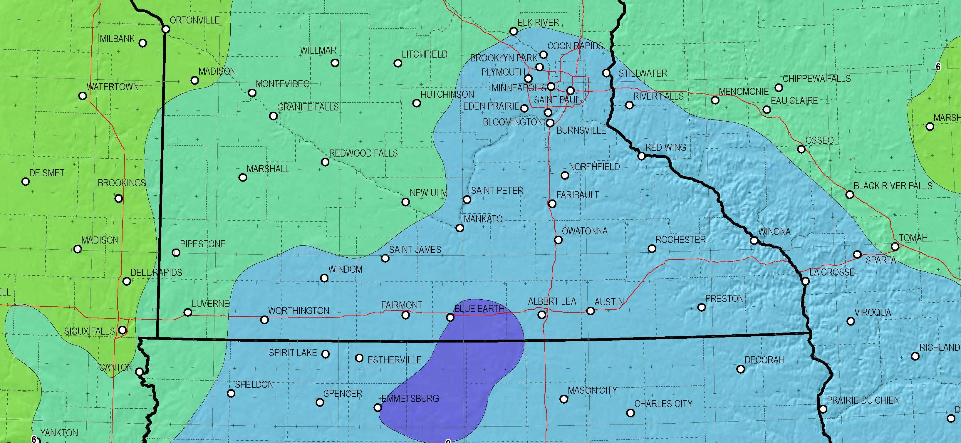
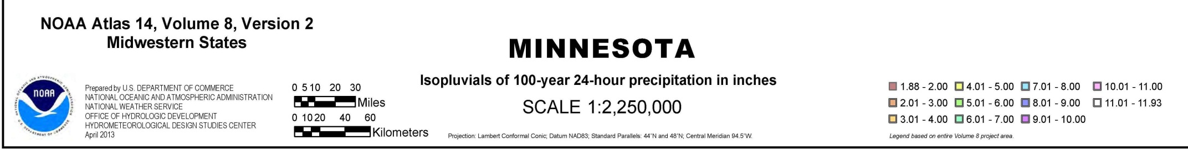
Precipitation Trends

Slide 5
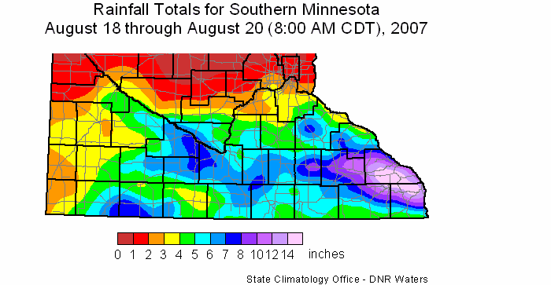
Notes:
Summary
A series of thunderstorms moving along a stalled frontal boundary dropped extremely heavy rain on much of southern Minnesota on August 18, 19, and 20, 2007. The most intense precipitation rates occurred during the afternoon and evening hours of Saturday, August 18, and the early morning hours of Sunday, August 19. Over the course of the event, all or portions of 28 counties received at least four inches of rain. Six-inch totals were common across the region, and portions of southeastern Minnesota reported astounding rainfall amounts ranging from 8 to 20 inches. The heaviest rainfall reports came from Winona, Fillmore, and Houston counties, where 36-hour totals exceeded 14 inches. The largest multi-day rainfall total reported (through Monday, August 20) was 20.85 inches observed near the town of Houston in northern Houston County. An official National Weather Service climate observer near Hokah in Houston County reported a storm total of 16.27 inches. Of the 16.27 inches, 15.10 inches fell within the observer's 24-hour observation cycle ending at 8:00 AM on Sunday, August 19. This is the largest 24-hour rainfall total ever recorded by an official National Weather Service reporting location in Minnesota. The previous Minnesota record was 10.84 inches, measured at Fort Ripley in Crow Wing County on July 22, 1972.
The deluge produced flooding tied to seven fatalities. Major flood damage occurred in many southeastern Minnesota communities. Hundreds of homes and businesses were impacted. Reports of stream flooding, urban flooding, mudslides, and road closures were numerous throughout southern Minnesota.
The combination of huge rainfall totals and a very large geographic extent, make this episode one of the most significant rainfall events in Minnesota's climate history. A six-inch rainfall total for a given location in this region over a 24-hour period is said to be a "100-year" (1% probability) storm. The area receiving six or more inches during a 24-hour period in the midst of this torrent encompassed thousands of square miles. Other heavy rainfall events during this decade of comparable magnitude and spatial coverage include extraordinary rainfalls in northwestern Minnesota on June 9-10, 2002, and in southern Minnesota on September 14-15, 2004.
Further Discussion of Rainfall Return Period:
When addressing the relative rarity of this rainfall event, it is useful to focus on a single location to use as a case study. As detailed above, an official National Weather Service Cooperative observer located one mile south of Hokah (Houston County) recorded 15.10 inches of rain for the 24-hour period from 8:00 AM, Saturday, August 18 to 8:00 AM, Sunday, August 19. The 3-day storm total for this location was 16.27 inches. This was not the largest rainfall total reported from the storm event, however the value has the endorsement of a multi-agency "climate extremes committee" and is easily defensible. Other "non-official", nevertheless quite valid, rainfall reports coming from other locations in southern Winona and northern Houston counties support the conclusion that the Hokah observation represents the rainfall amounts for at least two hundred square miles in that vicinity.
The 15.10 inch 24-hour total is the largest 24-hour rainfall total ever recorded by an official National Weather Service reporting location in Minnesota. This is a significant detail. The National Weather Service has maintained a network of 150 to 200 volunteer weather observers for 116 years. The previous Minnesota record was 10.84 inches. For the Hokah report to top this record by over four inches is truly remarkable.
The probability of receiving six or more inches of rain in a 24-hour period, in a given year, for a given location in southeastern Minnesota is approximately 1% (100-year storm). One can logically infer that the probability of receiving 15 inches of rain in a 24-hour period is far, far less than 1%. The question becomes ... how much less? Is it 0.2% (500-year), 0.1% (1000-year), 0.01% (10,000-year), etc.?
As mentioned, there are over 100 years of rainfall data available for many Minnesota locales. The challenge is to extrapolate to recurrence intervals that reach beyond our recorded experience. Mathematical techniques are available to make those extrapolations. The technique utilized, along with the data sets used for input, can create a variety of answers, none of which can be declared as "truth". The Minnesota State Climatology Office has determined that a "generalized logistic distribution" used on two long-term data sets from southeastern Minnesota offers the best visual representation of the extreme value behavior. Using this distribution and these data sets, the State Climatology Office estimates that the 15.10-inch 24-hour total reported at Hokah has a return period of somewhat over 2000 years.
The Probable Maximum Precipitation (PMP) value for a 24-hour period in southeastern Minnesota is approximately 31 inches. The PMP is a hypothetical upper limit reflecting the atmosphere's capacity for producing a perfect rainmaker in a given area.
The return period discussion above revolves around extreme value statistics for a single location. If one takes into account the considerable area receiving the extraordinary rainfall totals, the August 18-20 event becomes even more statistically improbable.
When asked to provide a recurrence interval estimate for this event, an investigator should note the enormous gap between the 100-year 24-hour threshold (six inches), and the fifteen or more inches that fell during a 24-hour period on that ill-fated weekend. Although a precise recurrence interval cannot be determined, we can safely state that the probability of being subjected to such an occurrence was considerably below one percent. What are, from a risk management perspective, the meaningful distinctions between a 1.0% (100-year) probability, a 0.1% (1000-year) probability, and a 0.01% (10,000-year) probability of occurrence? That is to the judgment of the investigator.

Slide 6
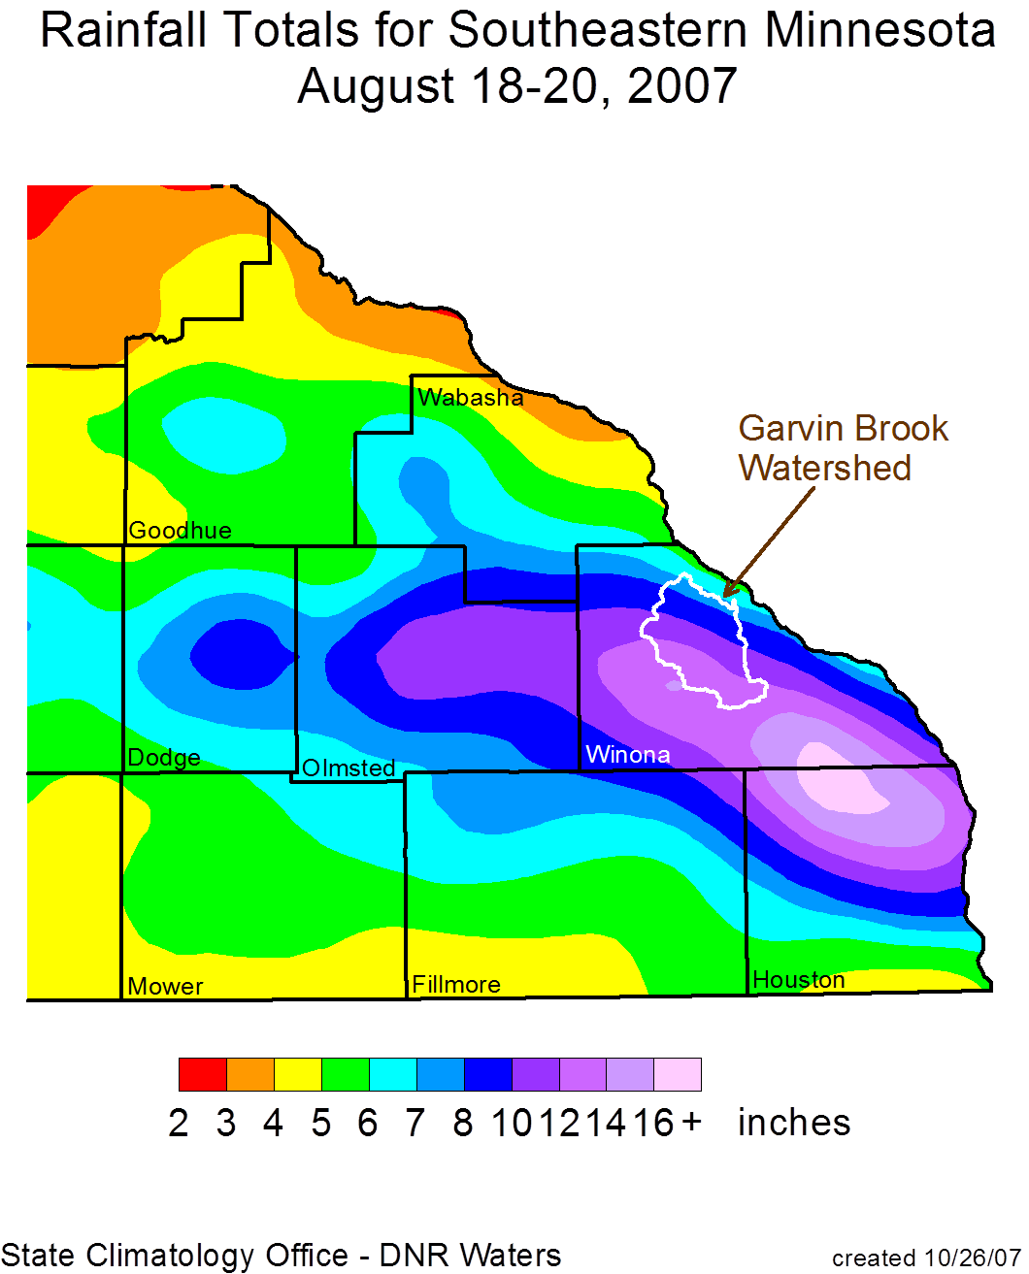

Slide 7
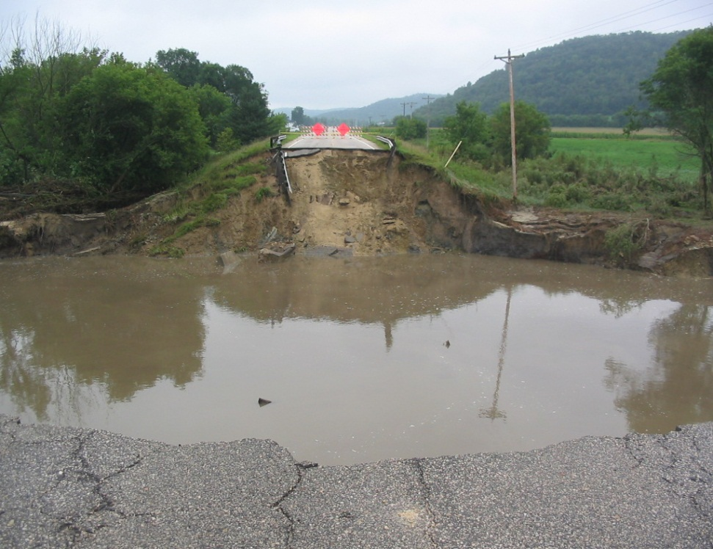
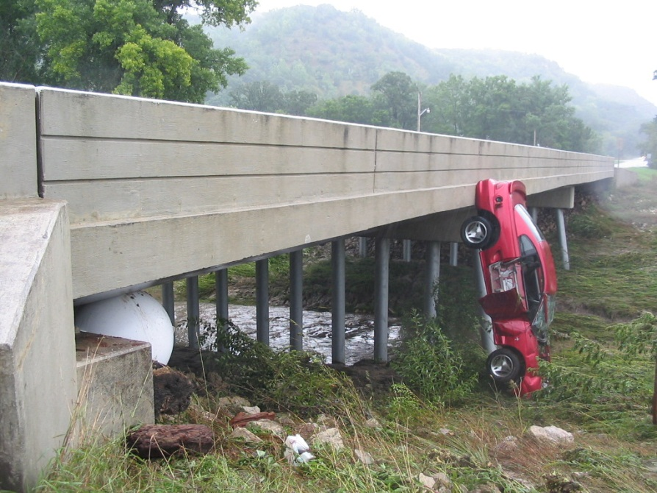
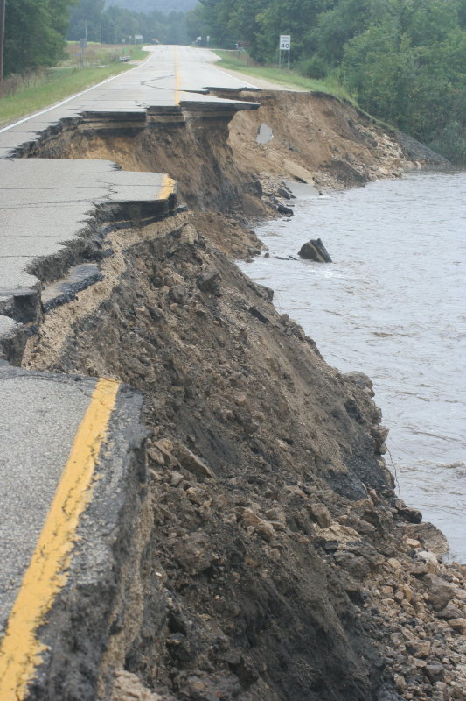
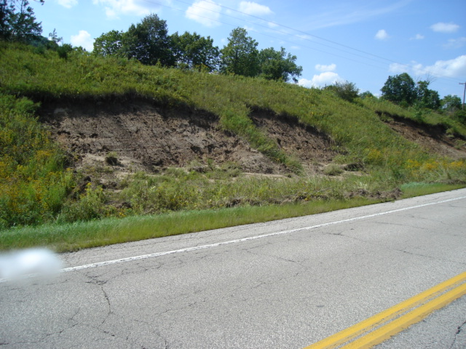

Slide 8
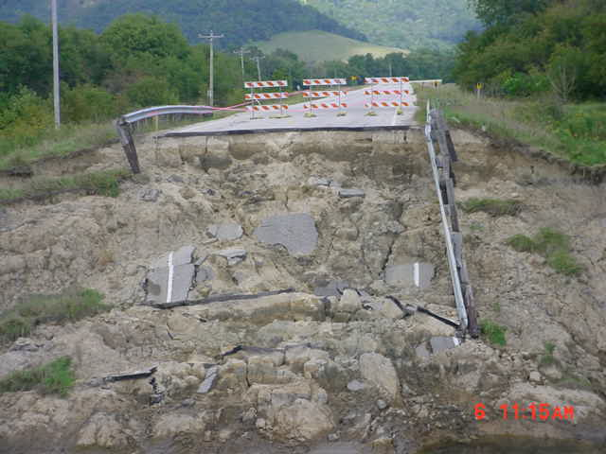
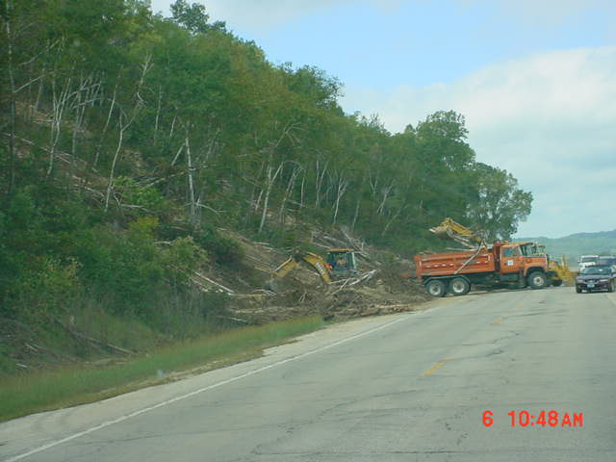
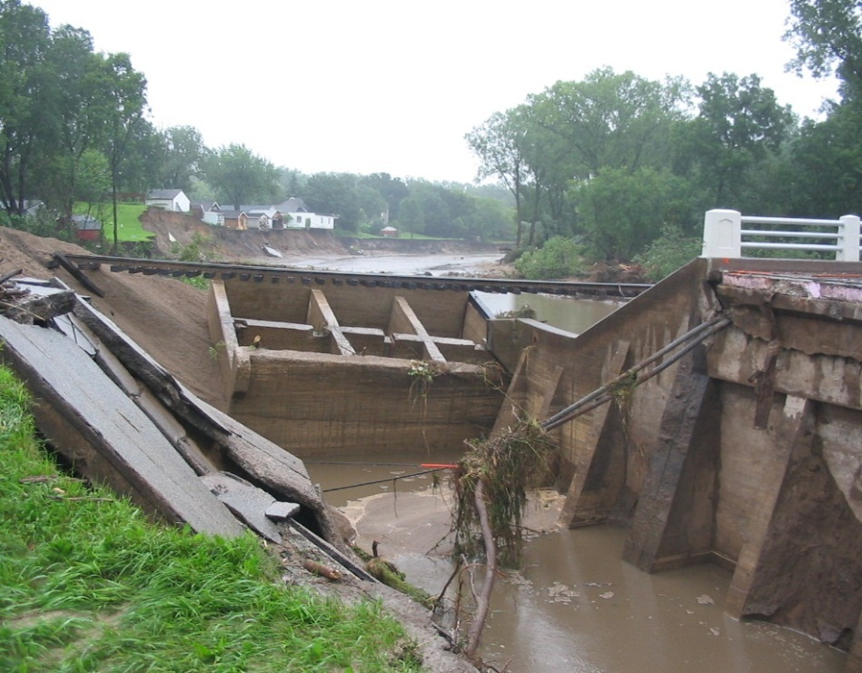
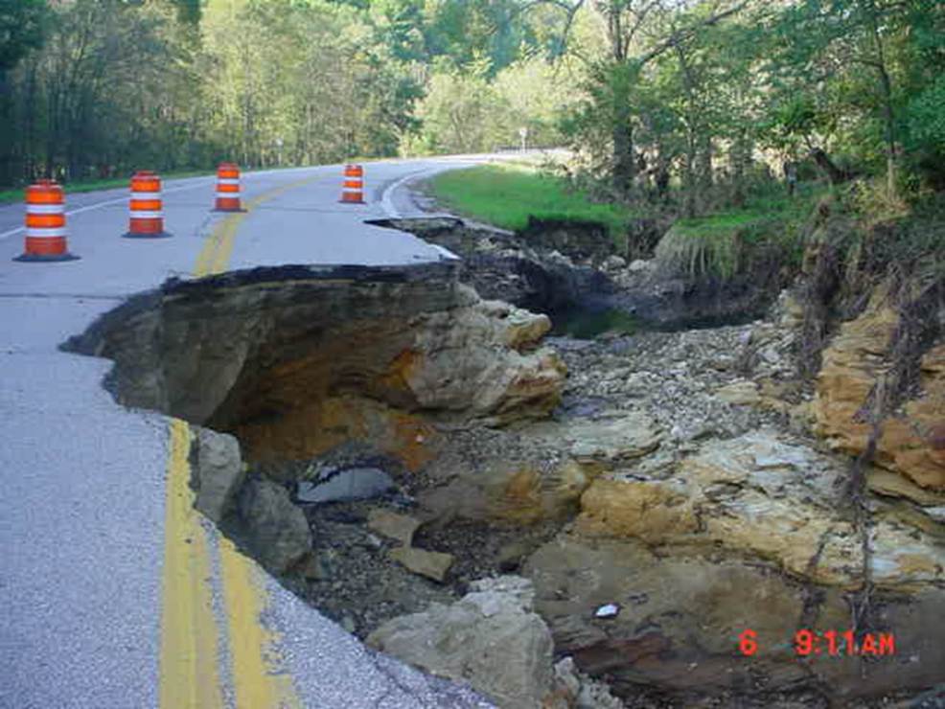

Slide 9
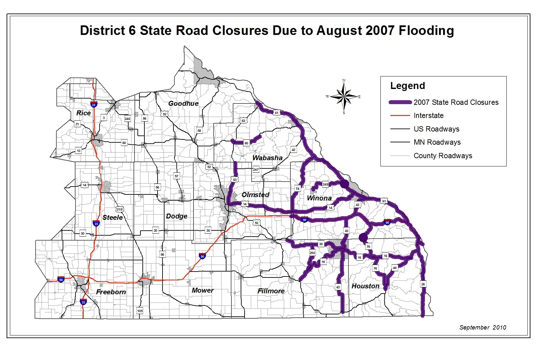

Slide 10
2007 Flood Damage Summary
Affected 16 State Highways
Submitted 91 Detailed Damage Inspection Reports (DDIR) for Federal Reimbursement
$12.5 Million in Emergency and Contract Repairs

Slide 11
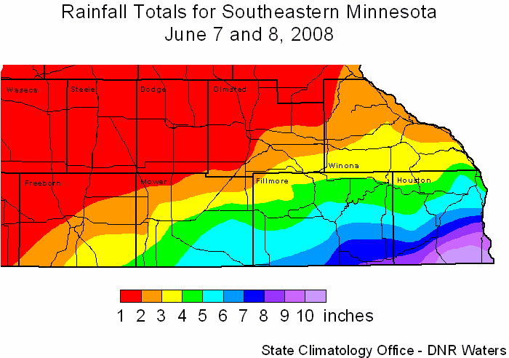
Notes:
Event Synopsis
A stationary front extended from southwest Iowa into Wisconsin on June 7 and 8 and triggered wave after wave of intense thunderstorms over Iowa, Wisconsin and far southeast Minnesota. Some of the hardest hit areas in Minnesota were Fillmore and Houston Counties. Ground that was already saturated from heavy rains the week before only compounded the problem. Houston County's Board of Commissioners declared a state of emergency on June 9. In Fillmore County, waters from the swollen Root River flooded Preston, and affected from 50 to 75 homes and twelve businesses in the downtown area. The highest two-day total in Minnesota was 10.61 inches about six miles southeast of Caledonia in Houston County. U.S. 52 was also closed in Fillmore County from Highway 44 near Harmony to the Iowa border.

Slide 12
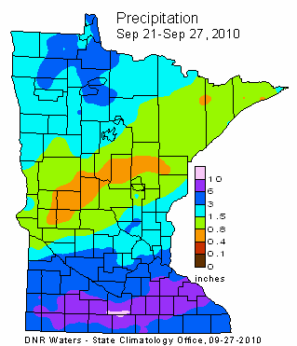
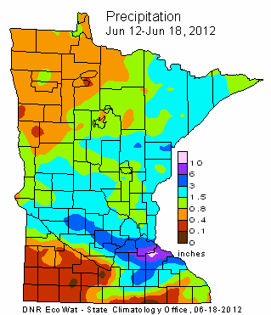
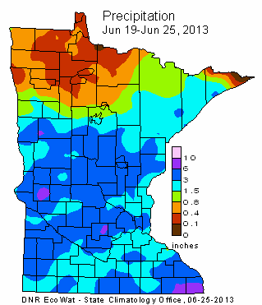

Slide 13
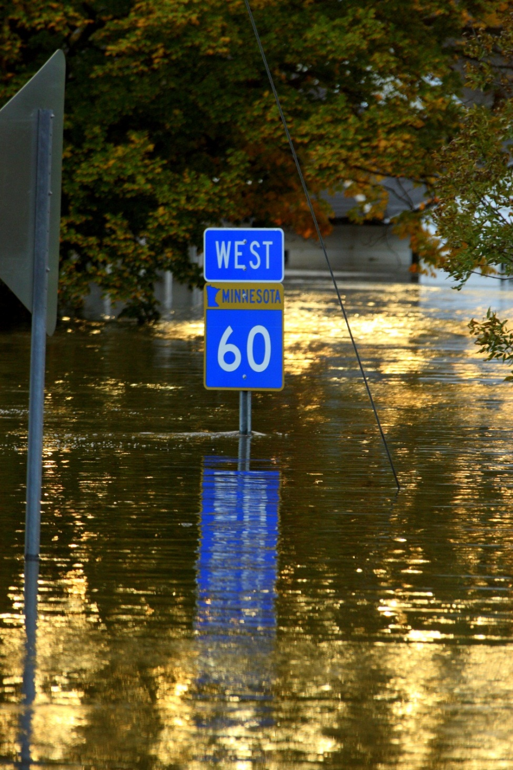
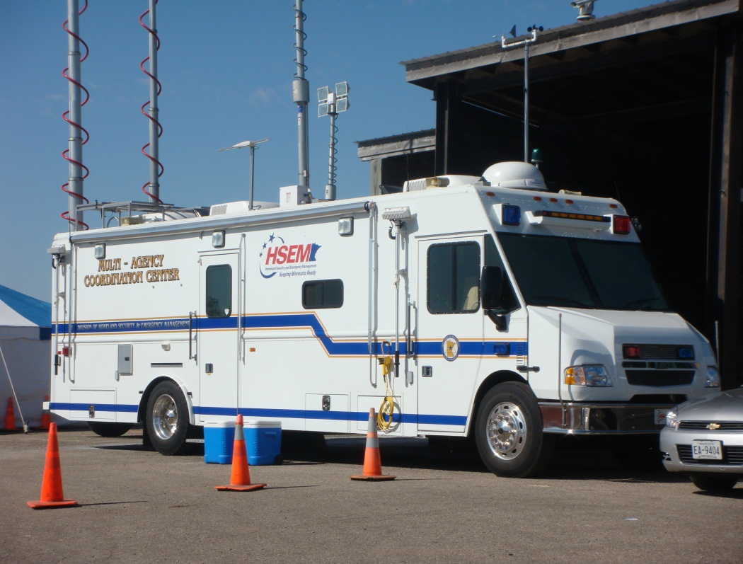

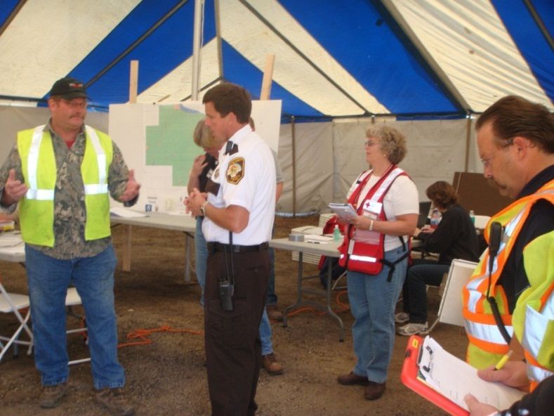

Slide 14
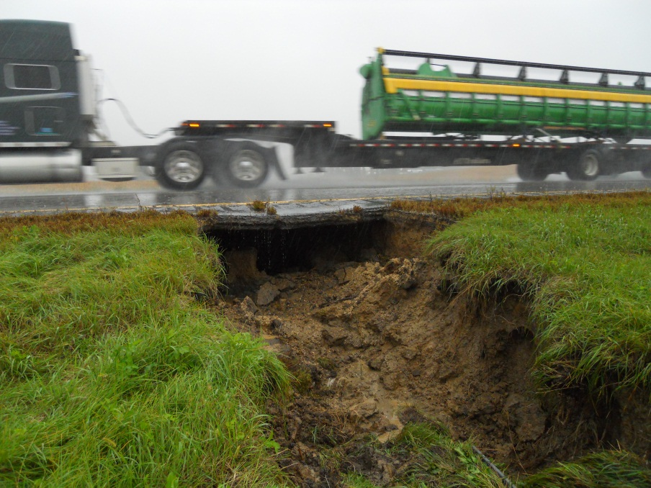
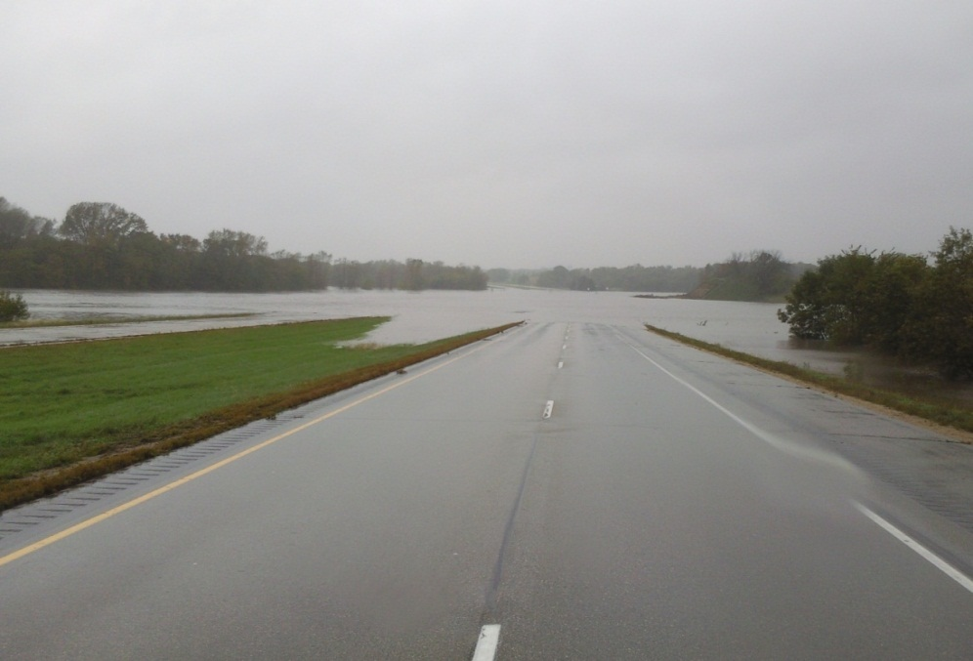
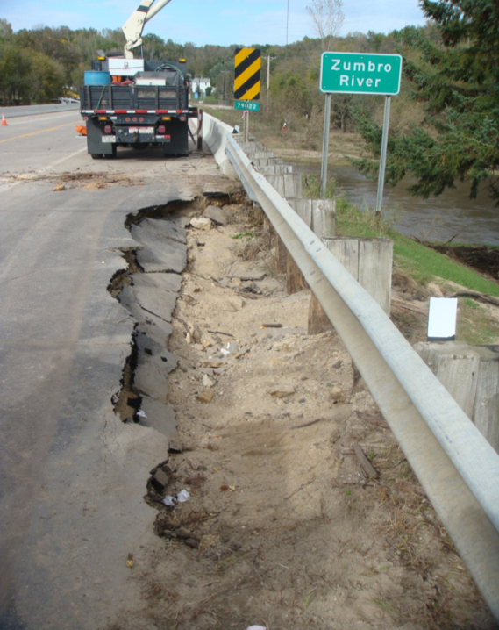
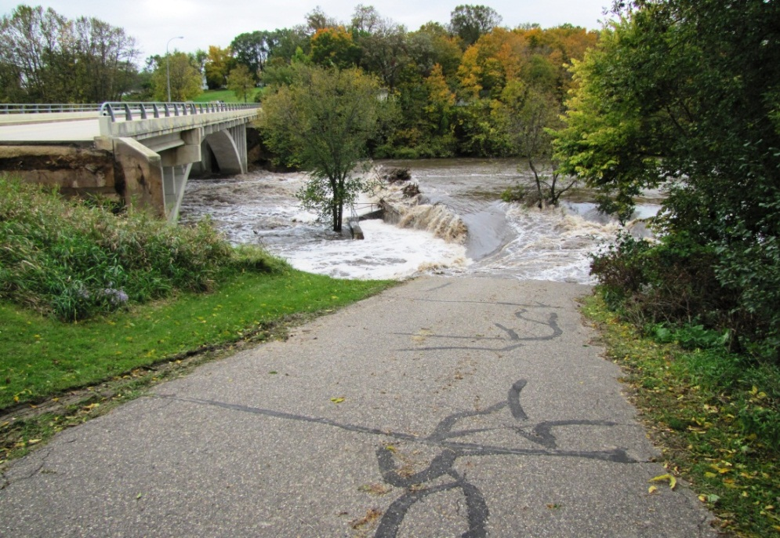

Slide 15
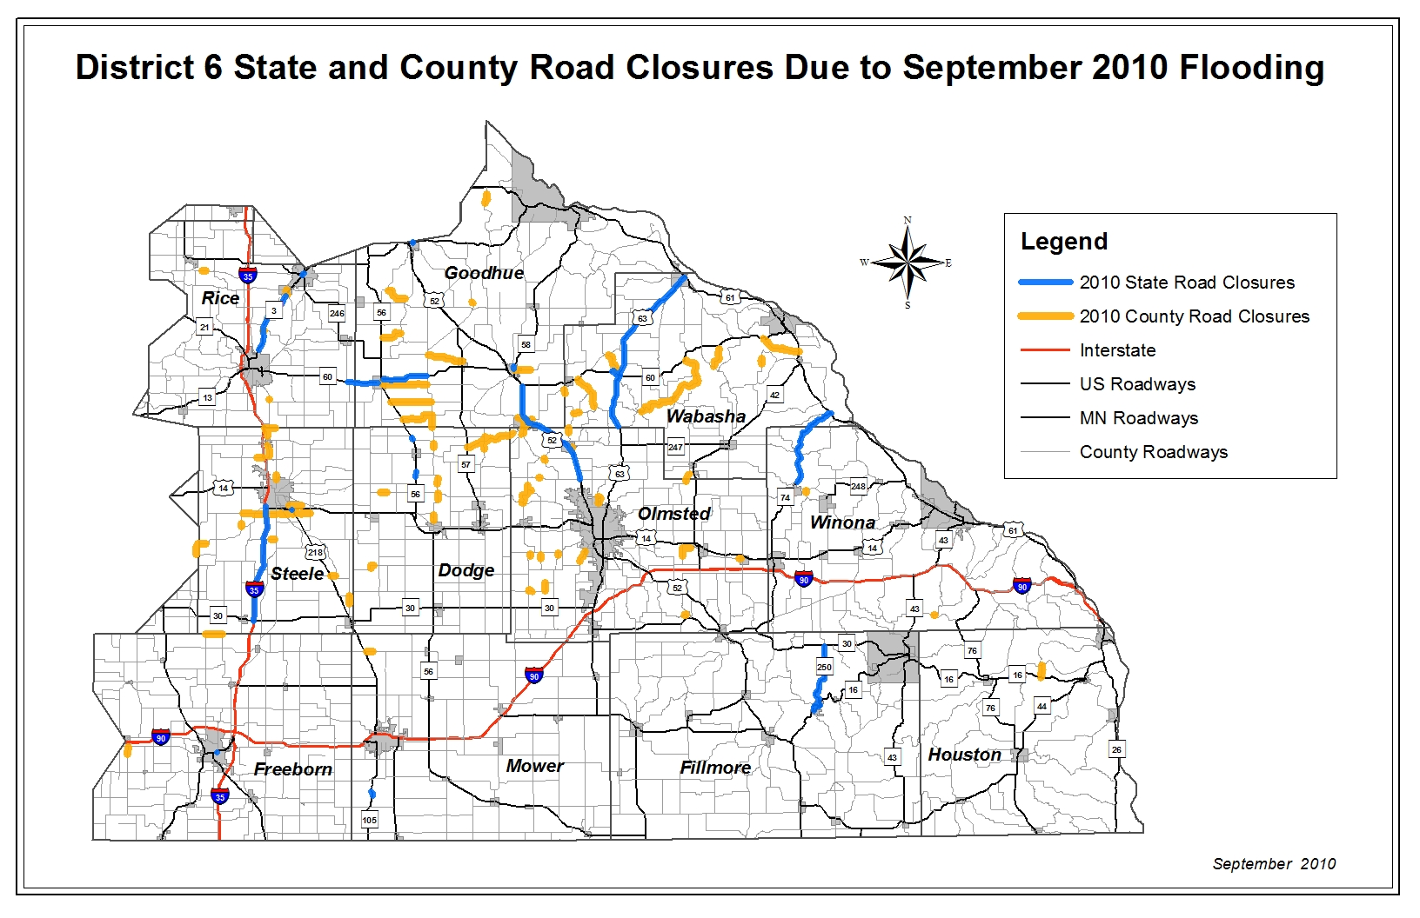

Slide 16
2010 Flood Damage Summary
Affected 22 State Highways
Submitted 38 Detailed Damage Inspection Reports (DDIR) for Federal Reimbursement
$1.9 Million in Emergency and Contract Repairs

Slide 17
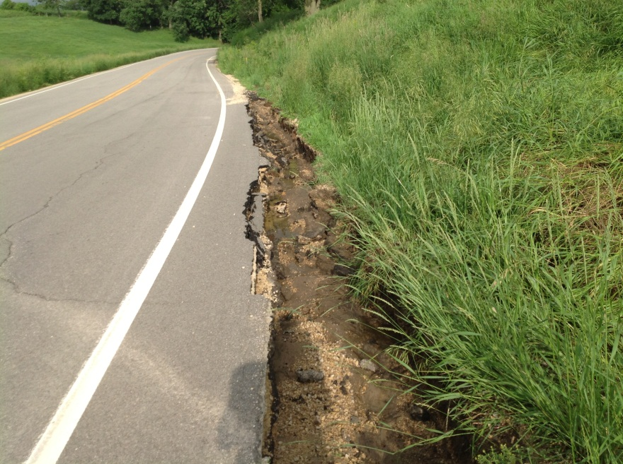
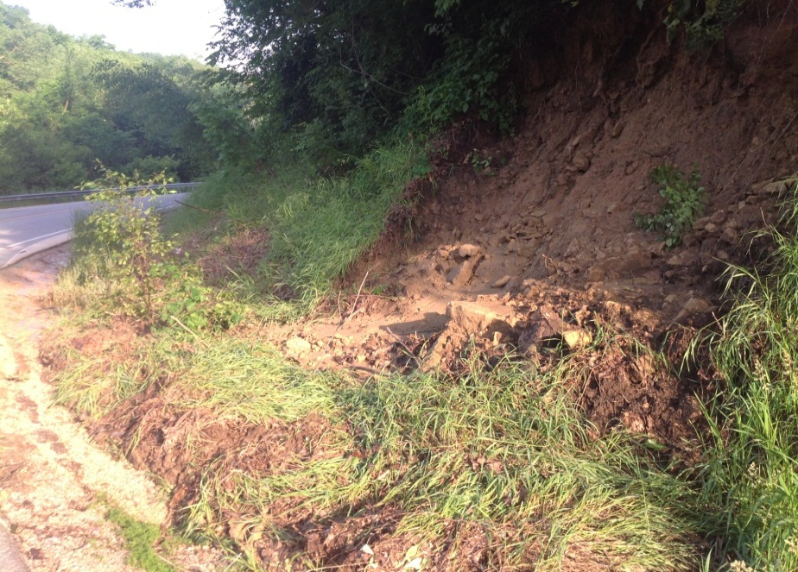
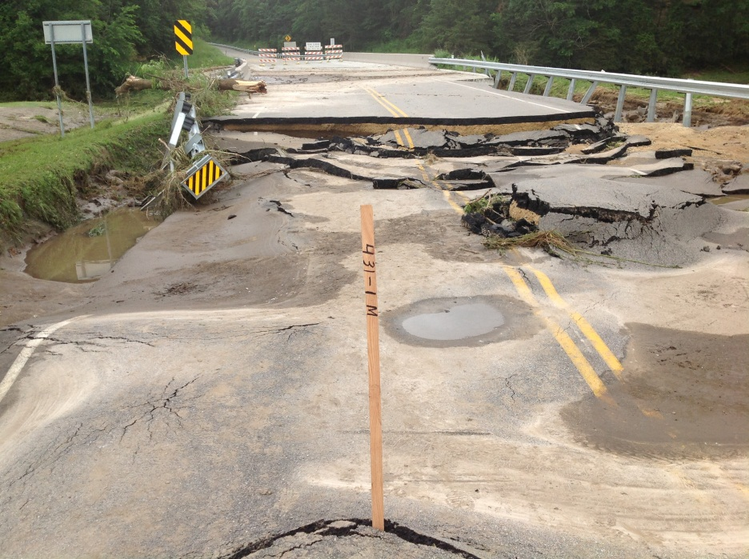
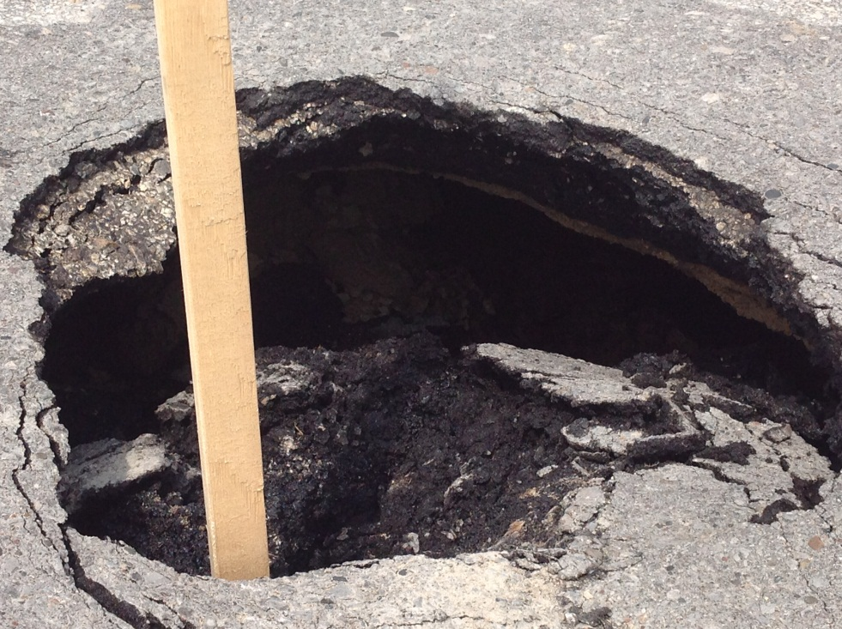

Slide 18
Current Risk Based Assessment
No Formal Process to identify Risk
Rely on Field Experience/History to know where potential issues could arise

Slide 19
Response Plan Methods
No formal Standard Operating Procedure (SOP)
District staff meeting to develop a flood response SOP
When an event happens – State Patrol and/or District Maintenance assess the Situation
  Minor Event and Risk Response is Maintenance Action
  Major Event and Risk; Multi-Jurisdictional/Emergency Operations Center
All Instances; Public Affairs issues press releases

